Slide 1

Virtual Warehouses

Slide 2
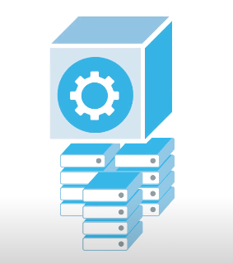
A ‘Virtual Warehouse’ is a cluster of one or more compute resources used to process queries and other DML operations

Slide 3
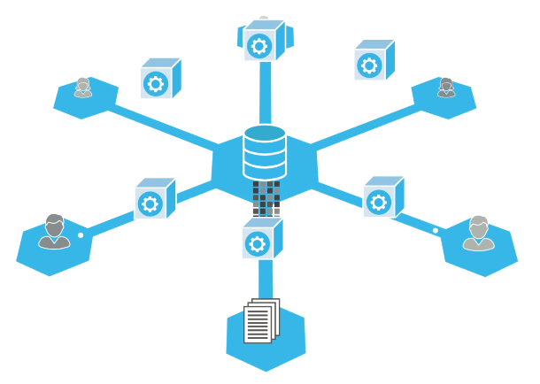
Requirement specific Warehouse choosing
Processing Queries VW
Processing Queries VW
Data loading VW

Slide 4
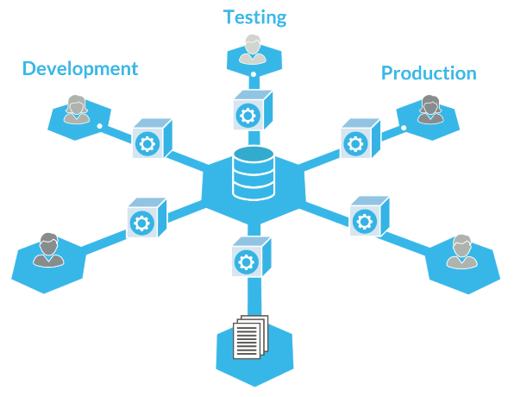
Environment specific Warehouse choosing

Slide 5
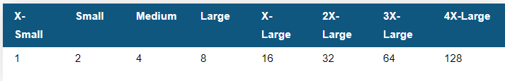
Warehouses come in different sizes.
The size of warehouse determines the number of servers in each cluster in the warehouse.
No. of EC2 Servers on AWS

Slide 6
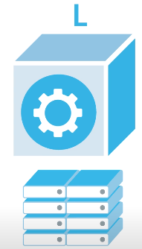
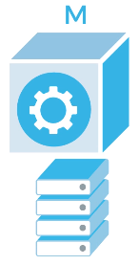
Each incremental increase in size doubles the number of servers at the same time cost will be increased

Slide 7


Sometimes if resources are not available to concurrently process all queries, then queries get queued for execution and then gets executed as resources becomes available..

Slide 8
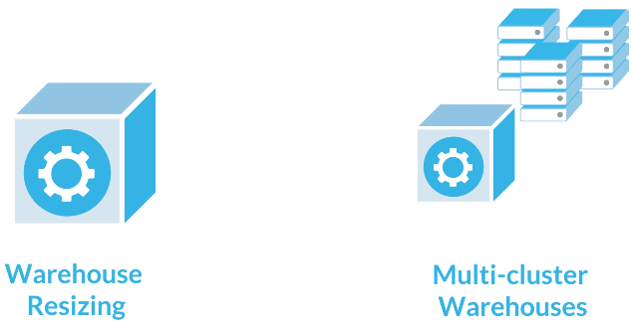
Snowflake provides two options for increasing the computer resources

Slide 9
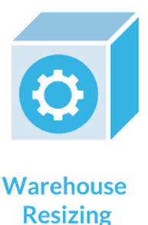
Scale Up (or)
Vertical Scaling
(Increasing or decreasing the size of virtual warehouse)

Slide 10
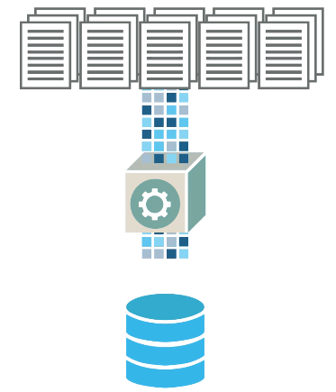
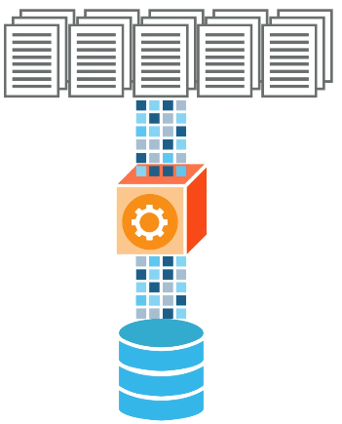
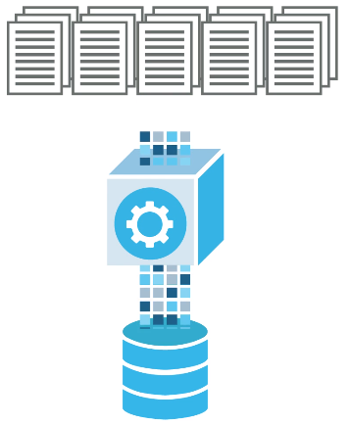
M
M
L
Resizing - Increase the size of the VW if your queries are taking too long or data loading is slow

Slide 11
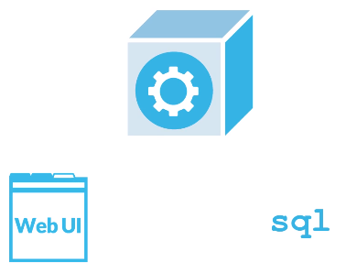
You can increase the VW anytime using the Web UI or SQL interface

Slide 12
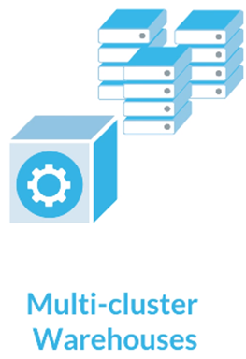
Scale Out (or)
Horizontal Scaling
(Increasing or decreasing the number of clusters)

Slide 13

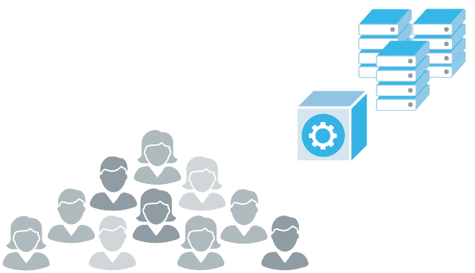
Off-Peak hours
Peak hours
As load increases the same warehouse will automatically starts more cluster to prevent queries from queuing. Then when additional clusters are no longer needed, it shuts those additional cluster which were launched. Multi-Clustering is an ENTERPRISE EDITION feature..

Slide 14
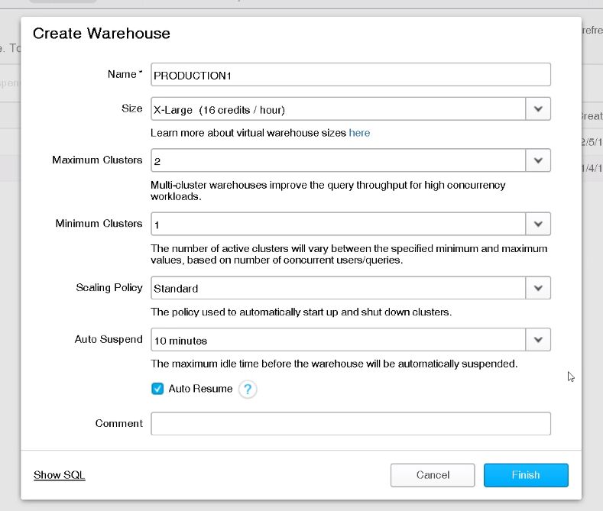
Auto Suspend and Auto Resume to save cost

Slide 15
Thank You

